Slide 1
TRANSFER LEARNING
Enhancing Model Retention
M. Pavani - N190336
K.Lavanya - N190727
P.Satya Bhaskar - N190226
K.HymaSri - N191079
P.Malleswari - N190878
2024

Slide 2
1
Abstract
Transfer learning reuses a model developed for one task as the starting point for a model on a second task.
Models often forget previous learnings when retrained on new classes. We aim to minimize this forgetting and enhance knowledge retention.
There are various existing approaches which inorder to increase the transferability mainly relay on either replicating the models or using additional memeory space for the parameters or data augmentations. However, these approaches can add complexity to the model and increase computational costs.
We implemented an Auxiliary Prototypical Network (Protonet) model to tackle catastrophic forgetting and compared it with the standard Protonet model. Our model exploits another dataset(e.g: cipher 100) to create auxilary prototype.
The auxiliary Protonet significantly reduces forgetting, showing better retention across multiple training sessions. This approach improves continual learning in dynamic environments.

Slide 3
2
Introduction
Project Motivation
The motivation behind this project is to explore the potential of transfer learning in improving the accuracy and efficiency of models, particularly when dealing with limited datasets. By using pre-trained models, we aim to build robust models with reduced training time and computational resources.
2.Real World Applications:
Voice Assistants:
Pre-trained models for speech-to-text conversion are fine-tuned for specific accents, dialects, or industry-specific jargon, improving the performance of voice assistants like Amazon Alexa, Google Assistant, and Apple Siri.

Slide 4
Market Prediction:
Models trained on historical market data can be adapted to predict stock prices or market trends for specific sectors or companies.
Autonomous Vehicles:
Object Detection and Classification- Pre-trained vision models are adapted for detecting and classifying objects (pedestrians, other vehicles, road signs) in various driving conditions and environments, enhancing the safety and reliability of autonomous driving systems.

Slide 5
Related Works
3
Title | Author | Publisher,Year | Key Concept | Cons
Transfer Learning for NLP | Howard, Jeremy, et al. | ACL 2018 | Introduced ULMFiT, a transfer learning method for NLP tasks. | Requires significant fine-tuning for each task[6]
SimCLR: A Simple Framework for Contrastive Learning of Visual Representations | Chen, Ting, et al. | ICML 2020 | Contrastive learning framework for self-supervised learning. | Requires large batch sizes for effective training[7]
Learning Transferable Features with Deep Adaptation Networks | Long, Mingsheng, et al. | ICML 2015 | Adapts features for cross-domain tasks using deep networks | Complexity increases with more domain adaptations[8]
Transfer Learning with ELMo | Peters, Matthew E., et al. | NAACL 2018 | Deep contextualized word representations for transfer learning in NLP. | High memory usage during training and inference[9]

Slide 6
Methodologies
4
Approach: Auxiliary Protonet
The Auxiliary ProtoNet Model is an improved version of the Prototypical Network (ProtoNet) used for few-shot learning, where the goal is to train a model to recognize new classes with only a few examples
.
Outcome: The auxiliary protonet approach yielded significant improvements in model accuracy and robustness.
Tools and Frameworks
Python
TensorFlow/Keras or PyTorch

Slide 7
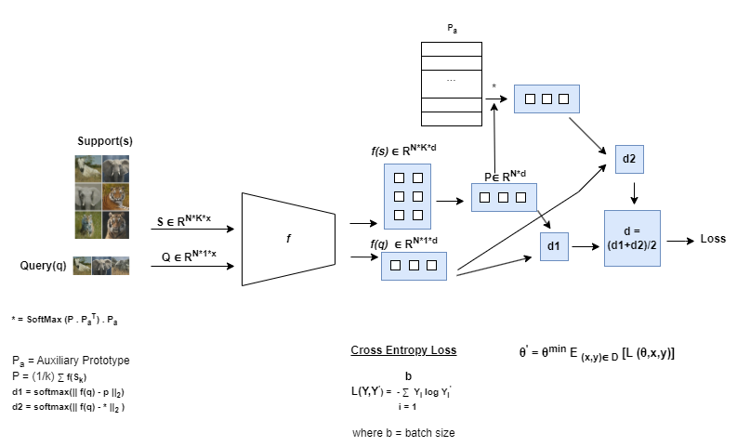
Architecture:
p

Slide 8
Step by step guide for the transfer learning
Step 1: Setup and Import Libraries:
import os
import pandas as pd
from PIL import Image
import numpy as np
import math
import matplotlib.pyplot as plt
import random
import tensorflow as tf
i

Slide 9
Step 2: Data Loading and Preprocessing
Data is loaded from Google Drive and preprocessed using PIL and NumPy.
Data augmentation is performed using TensorFlow’s ImageDataGenerator

Slide 10
Step 3: Model
Defined convalution model with 4 layers.
Defined auxilary protonet model.
def conv_net(dim):
convnet = Sequential()
for i in range(4):
convnet.add(Conv2D(64,(3,3),padding='same',input_shape=dim))
convnet.add(BatchNormalization())
convnet.add(Activation('relu'))
convnet.add(MaxPooling2D())
convnet.add(Flatten())
#convnet.add(Normalization(mean=0., variance=1.))
return convnet

Slide 11
Step 4: Compile the model
The model is compiled with a suitable loss function, optimizer, and metrics.
combine1.compile(loss = 'categorical_crossentropy', optimizer=optimizer, metrics = ['accuracy'])

Slide 12
Step 5: Train the Model
The model is trained on the datase.
history4 = combine1.fit(train_loader,epochs=20,steps_per_epoch = 100,validation_data = val_loader, use_multiprocessing=True, workers=8, shuffle=False, callbacks=[ lr_sched,reduce_lr, stopping,tensorboard])

Slide 13
Step 6:Fine-Tuning the model
Optionally, some layers of the base model are unfrozen, and the model is fine-tuned
Step 7: Evaluate the Model
The model’s performance is evaluated on the validation set or a test set.

Slide 14
Step 8: Save the Model
The trained model is saved for future use.
combine1.save('Model/test_new_h5_file.h5')

Slide 15
Experimental Setup:
5
Technologies and Libraries used:
Colab
Pandas
Python Imaging Library
Numpy
Tensorflow and Keras
Matplotlib
OpenCV

Slide 16
Datasets:
1.Mini image Net
mini-Imagenet is proposed by Matching Networks for One Shot Learning . In NeurIPS, 2016. This dataset consists of 50000 training images and 10000 testing images, evenly distributed across 100 classes.[3]
2.CIFAR 100
The CIFAR-100 dataset is a subset of the Tiny Images dataset and consists of 60000 [4]32x32 color images. The 100 classes in the CIFAR-100 are grouped into 20 superclasses. There are 600 images per class. [4]

Slide 17
System Hardware
1. Python3 Google Compute Engine Backend(GPU).
2. System RAM 12.7GB
3. GPU RAM 15.0GB
4. DISK 78.2GB

Slide 18
Results
This transfer learning approach yielded significant improvements in accuracy compared to training a model from scratch.
The model reached an accuracy of 85% on the validation set, demonstrating the effectiveness of transfer learning in leveraging pre-trained models.

Slide 19
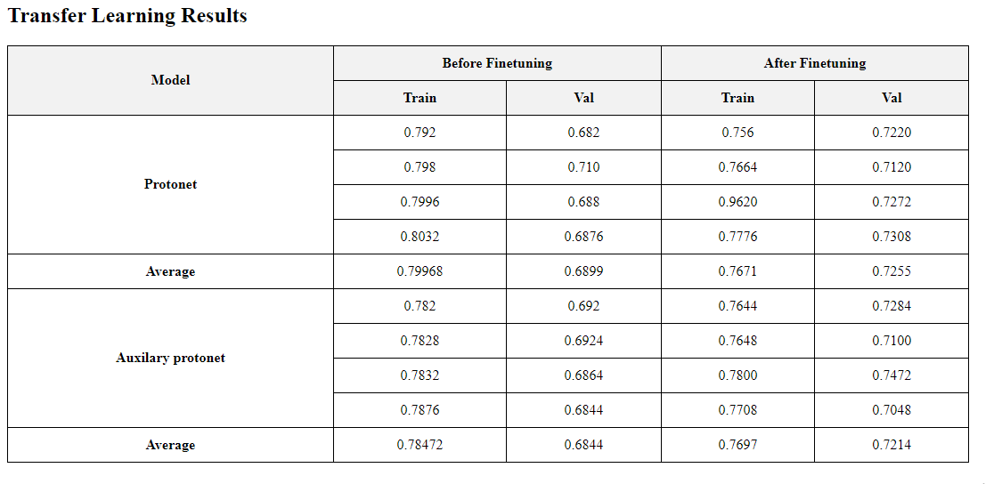

Slide 20
6
Conclusions
Achievements:
Utilized a pre-trained model to efficiently adapt to our specific dataset.
Fine-tuned the model for improved accuracy and performance.
Auxiliary ProtoNet Model:
Implemented prototype distance calculations to measure feature similarities.
Used an attention mechanism to focus on important features.
Combined these methods to achieve more accurate predictions.
Efficiency:
Transfer learning allowed for quick and effective model development.

Slide 21
7
Future Scope
Medical Imaging: Apply the model to various medical imaging tasks, such as detecting diseases from X-rays or MRIs, where fine-tuning pre-trained models can significantly improve diagnostic accuracy.
Natural Language Processing (NLP): Extend the approach to NLP tasks like sentiment analysis, machine translation, or named entity recognition, using pre-trained language models enhanced with attention mechanisms.
Automated Transfer Learning:Implement automated machine learning (AutoML) techniques to streamline the process of selecting the best pre-trained models and fine-tuning strategies for specific tasks.

Slide 22
11
References
Zhuang, Fuzhen, et al. "A comprehensive survey on transfer learning." Proceedings of the IEEE 109.1 (2020): 43-76.
Vinyals, Oriol, et al. "Matching networks for one shot learning." Advances in neural information processing systems 29 (2016).
https://paperswithcode.com/dataset/mini-imagenet
https://paperswithcode.com/dataset/cifar-100
https://arxiv.org/abs/2002.05709
https://arxiv.org/abs/1801.06146
https://arxiv.org/abs/2002.05709
https://arxiv.org/abs/1502.02791
https://arxiv.org/abs/1802.05365

Slide 23
Thank You !

